Slide 1

Shoes and Foot Health for the Working Woman
Gray Carpenter, PT,DPT,OCS,FAAOMPT
Mike Sherk, PT,DPT
Aimee Kasten, SPT

Slide 2
Objectives
Determine what type of foot you have and how to shop for products to increase comfort
Review different types of women’s shoes
Discuss how to avoid joint pain associated with certain shoe styles

Slide 3
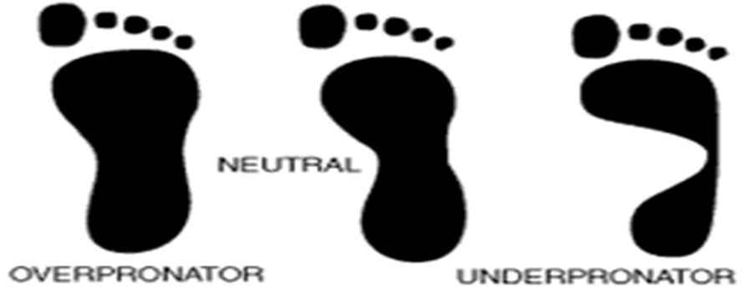
How to Determine Your Arch Type
“Wet Test”-most common method
  Fill shallow pan with thin layer of water
  Wet sole of foot
  Step onto a piece of paper
  Does it look similar to any shown below?

Slide 4
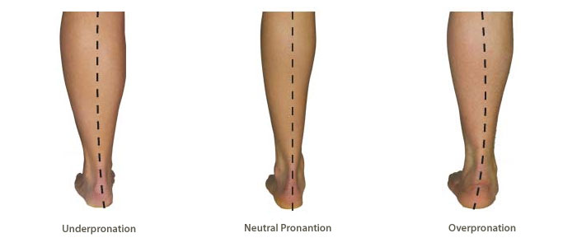
Determining Your Foot Type
High arches: Associated with underpronation.
  May notice walking on the outside of your foot
  Wet test: inner/middle part of foot does not appear
Collapsed arches: Associated with overpronation
  May notice foot collapses and walk more on the inside of foot
  Wet test: Foot appears large with no definite arch shape

Slide 5
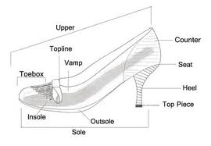
Determining the Right Fit for Any Shoe
Shoe shop later in the afternoon
  Feet swell/sweat during the day
Toe box
  Should be able to easily wiggle toes
Heel should fit snuggly
Your feet widen with age, so measure them each time you try on new shoes
  Buy shoes based on the LARGEST foot
  Different brands may result in different sizes

Slide 6
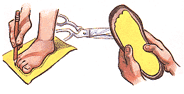
Choosing the Right Fit
Many shoes are narrower than your foot, especially in the front
Check this by tracing foot on piece of paper
  Compare the tracing with the sole of your shoe.
  A shoe that is too narrow (tracing is wider than the sole) may lead to foot and other lower extremity joint pain
http://www.footcaredirect.com/shoes.html

Slide 7
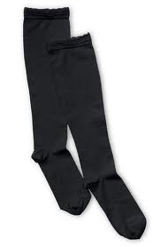
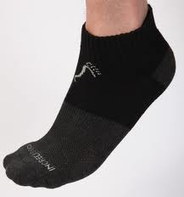
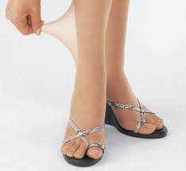
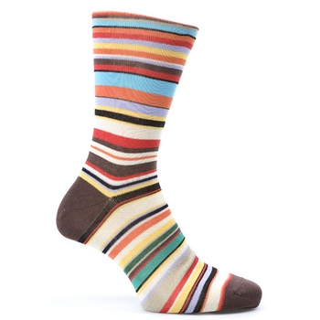
Considerations for Shoe Shopping
Bring the socks you plan to wear with the shoes
  Hose, trouser socks, & athletic socks differ in bulk and affect the fit
If you have wide feet, consider brands that offer width sizes (ex: 8W)

Slide 8
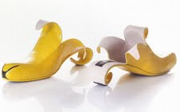
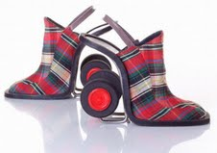
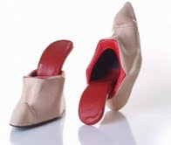
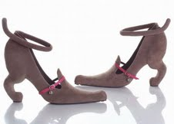
High Heels

Slide 9
High Heels-The Facts
3” heel creates 7x more stress on forefoot (balls of feet) than 1” heel
22% increase knee pressure with “stilettos”
26% increase knee pressure with wide high heels
Decrease walking speed & step length

Slide 10
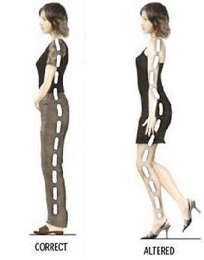
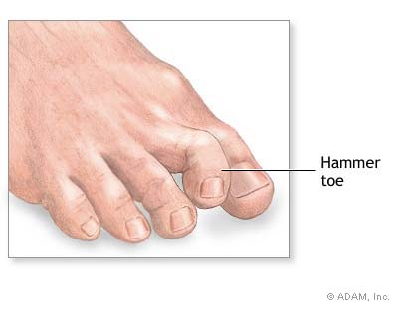
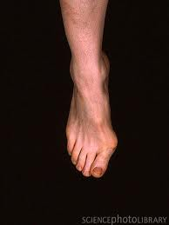
Consequences of Ill-Fitting Heels
Cramping and deformation of toes
Changes body posture, which can lead to joint pain
  Causes increased curve in low back – back pain
  More stress on knees and balls of feet

Slide 11
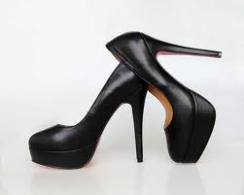
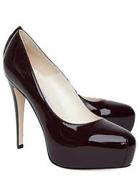
Shopping for (Comfortable) Heels
Consider shoes with heel height of 2 inches or less
If higher heel height is desired, look for shoes with platforms
  Take pressure off front of foot (balls of feet)
  Platforms can be exposed or covered for desired look
Exposed
Covered

Slide 12
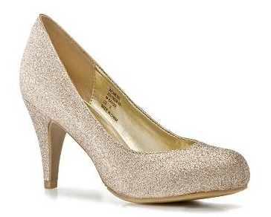
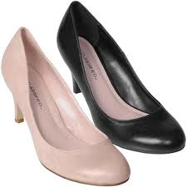
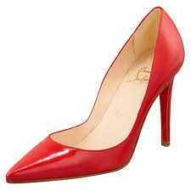
Shopping for (Comfortable) Heels
Consider a shoe with a rounded toe box instead of a pointed one
  Gives toes more room to spread when walking & standing
  Helps prevent toe deformities
Rounded
Pointed

Slide 13
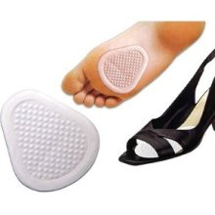
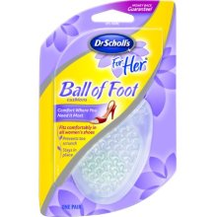
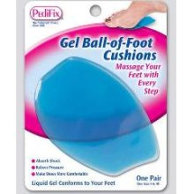
Shopping for (Comfortable) Heels
Research ball-of-foot inserts
  Decreases pressure on the ball of the foot
  Can help improve comfort of shoes you already own
  Available at most drug stores

Slide 14
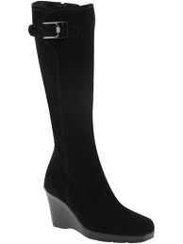
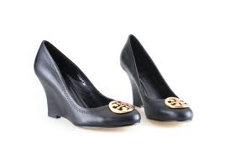
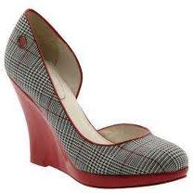
Shopping for (Comfortable) Shoes
Consider a “wedge” style of shoe
  Space between heel and forefoot of shoe is filled in
  Less likely to lose balance – more of shoe is in contact with the ground
  Pressure on forefoot foot is lessened

Slide 15
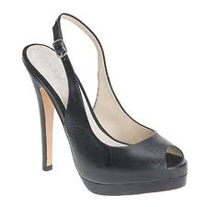
Shopping for (Comfortable) Heels
Slingbacks
  Lack of heel counter may cause instability for the heel of foot
  Make sure fasteners are tight – heel of foot should not be sliding off side of shoe
  If slingbacks are made of elastic/have no fasteners, be sure to monitor slack – fabric stretches over time
  Make sure heel of foot stays entirely on heel of shoe, both in sitting and walking before buying them

Slide 16
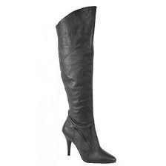
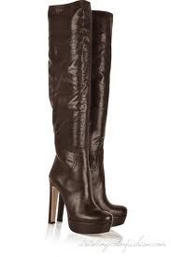
Dress Boots
Boots with heels
  Decreased heel height, platform, wedge style, or forefoot inserts
Mid-shin and knee-high boots
  Be sure to wear proper socks when trying on and wearing boots-material of legging of boot may irritate skin
  Make sure legging of boot fits comfortably around calf – tingling and numbness down legs may occur if too tight
  Lace-up boots offer the best customized fit

Slide 17
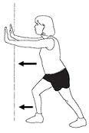
Suggestions for High Heel Wearers
Stretch back of lower legs after use
  Heels cause calf muscles to shorten
  3 sets of calf stretches, 30-40 seconds each (shown below)
If possible, put heels on after standing up
  Muscles of the back do not fire properly with higher heel heights when going from sit to stand
  May lead to back pain
Avoid wearing high heels for extended time
  If job requires excessive walking, change into
  flats or walking shoes
Notes:
Sit-to-stand: study showed erector spinae firing was latent during sit-to-stand task with 8cm heels when compared to lower (2cm) heel heights

Slide 18
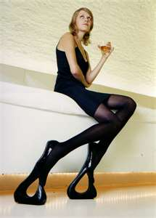
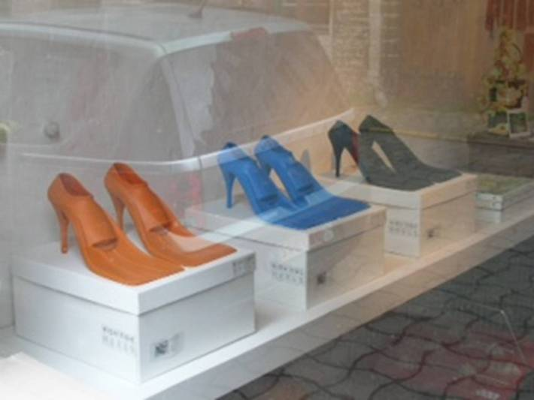
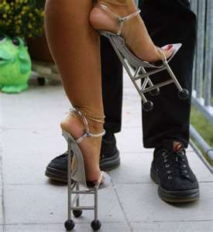
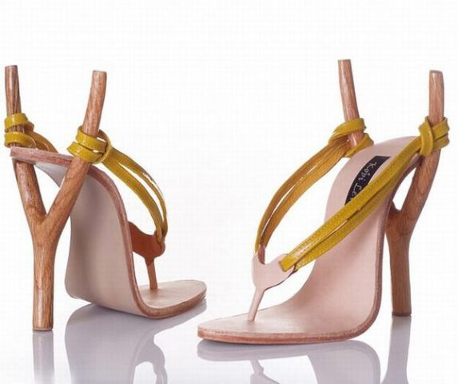
Fashion vs. Safety…
Excessive pressure on forefoot and knees
Tripping hazards?
Too small and narrow for foot
Notes:
Mention barefoot running…?

Slide 19
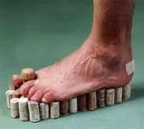
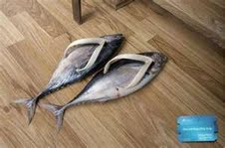
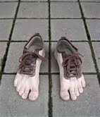
Flats

Slide 20
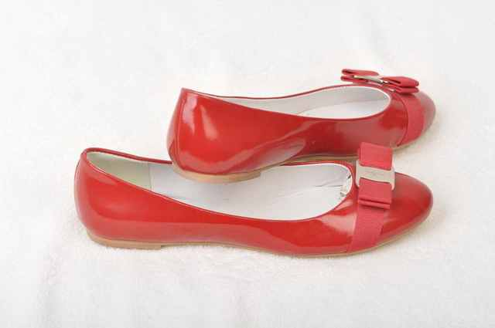
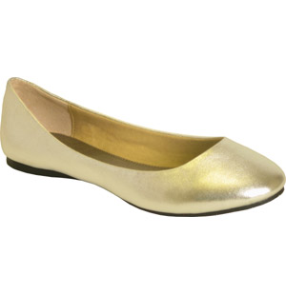
Flats
No heel keeps pressure more evenly distributed throughout entire foot
Less likely to develop toe deformities
Look for built-in arch support in most styles to lessen chances of developing joint pain

Slide 21
Walking Shoes
Best shoe to wear if work requires walking and standing for long periods of time
Provide the most support for all parts of the foot, including the inside arch
If fitted properly, decreases the likelihood of developing lower extremity joint pain, back pain, and toe deformities related to footwear
Notes:
**general considerations, may differ based on type of foot/needs…as previously mentioned**
It should twist; bend at the ball of the foot; should rock when poked (will help during walking to roll the foot)
Racewalkers – need a light, flexible shoe; most of these individuals rely on custom shoes
With running shoes – may bend at midfoot; may have wide (flared) heel to help with stability during heel strike; may have higher heel to help runners who strike at midfoot

Slide 22
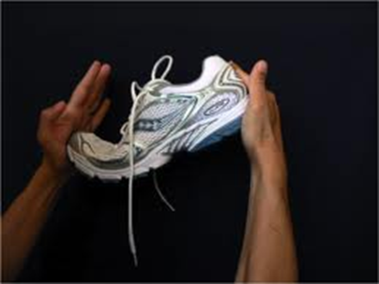
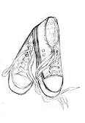
Buying the Right Walking Shoe
Flexibility
  Twist the shoe – middle of shoe should not twist or bend
  Bend the shoe – should only bend where the ball of the foot would be
Flat & No flare
  Heel should be no more than 1” higher than forefoot
  Heel should not be wide – should cup the heel in a snug but comfortable manner

Slide 23
Buying the Right Walking Shoe
Shoe should fit the type of arch and foot you have
Flat arches/Overpronation: Look for shoes with rigid medial arch support
High arches/Underpronation: Choose shoes with softer medial arch supports to allow the foot to collapse inward while walking

Slide 24
Buying the Right Walking Shoe
Certain specialty stores have trained staff that can help you assess your foot type and direct you to the proper shoe
  Off’n Running
  2201 Joan Avenue, Greensboro
  (336) 288-7071
  9th Street Active Feet
  725 Iredell Street, Durham
  (919) 286-5101

Slide 25

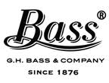





Our Sponsors
We would like to thank…

Slide 26
Questions?
Mike Sherk, PT,DPT
  919-304-5060
Gray Carpenter, PT,DPT,OCS,FAAOMPT
  336-538-7500

